Slide 1
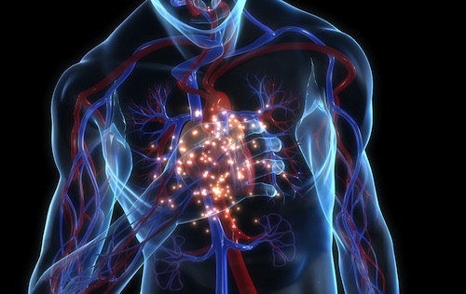
KCNQ1 and Long QT Syndrome
Daniel Burgardt

Slide 2
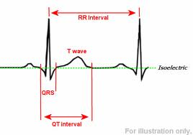
Long-QT Syndrome
“LQTS is a disorder of cardiac repolarization resulting in QT prolongation on an electrocardiogram.”¹¹
12

Slide 3
But…
LQTS can lead to many other symptoms, some far more serious than a longer QT interval.
  Sudden loss of consciousness
  Seizures
  Sudden death

Slide 4

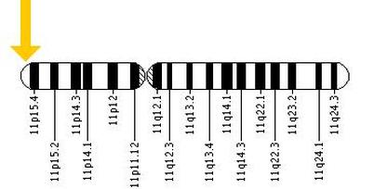
What causes these phenotypes?
Many reasons, some unknown, the main reason is mutations in the KCNQ1 protein.
Chromosome placement¹⁶

Slide 5
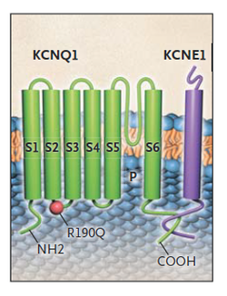
KCNQ1
A potassium voltage-gated channel, KQT-like subfamily, member 1
Helps shuffle potassium ions across membrane to repolarize heart cells
Must be phosphorylated in order to function
KCNQ1 protein structure¹⁵

Slide 6
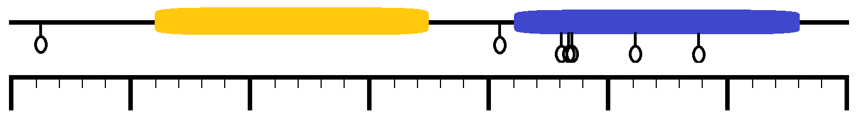
Phosphorylation sites in KCNQ1?
There are at least seven activating phosphorylation sites along the KCNQ1 protein¹⁵
Ion_trans
KCNQ_channel
676aa
S409
S464
T470
S577
S27
S468
T513
100
200
300
400
500
600

Slide 7
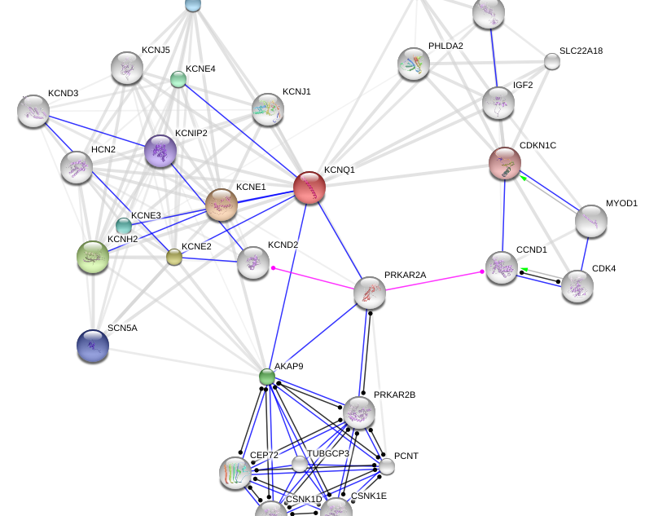
What phosphorylates KCNQ1?

Slide 8
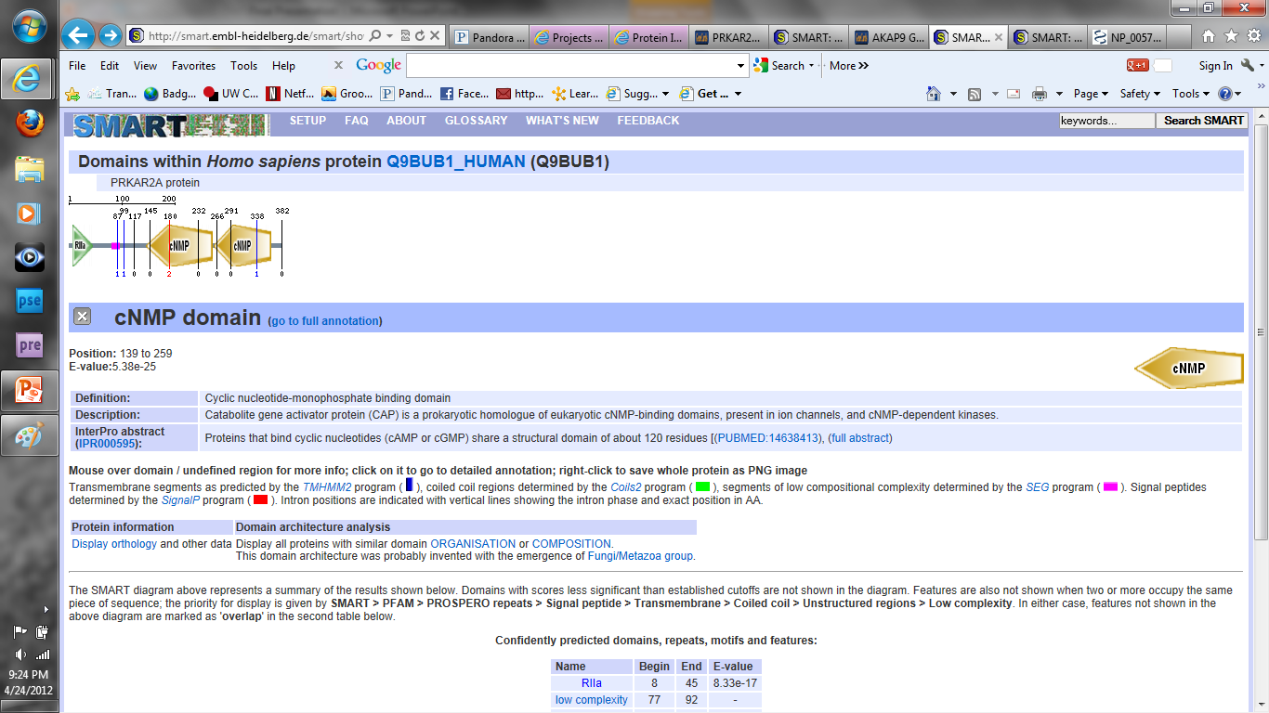
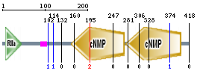
PRKAR2A/B
PRKAR2A
PRKAR2B
But they need help attaching to target proteins.

Slide 9
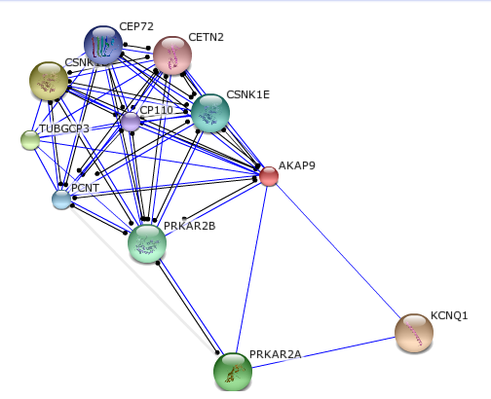
AKAP9 Protein
14

Slide 10
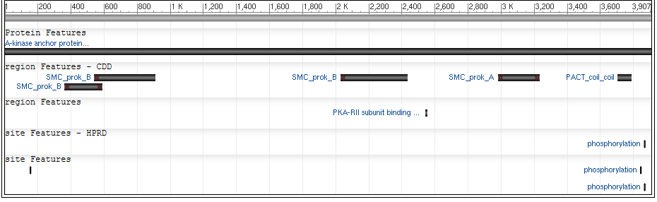
AKAP9 as a scaffold protein
The needed protein to attach the PRKAR2A/B complex to KCNQ1

Slide 11
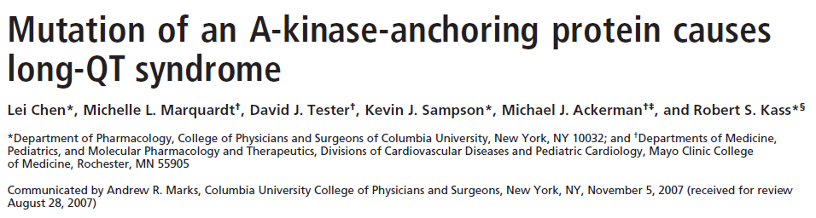
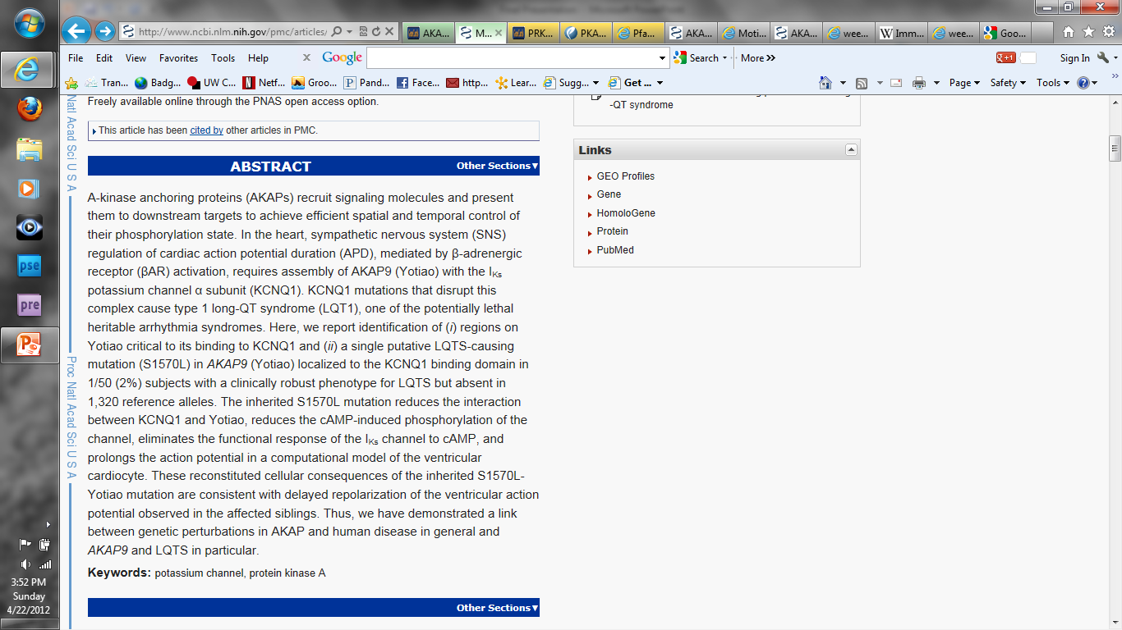
Previous Experiments
and the one I chose to challenge…

Slide 12
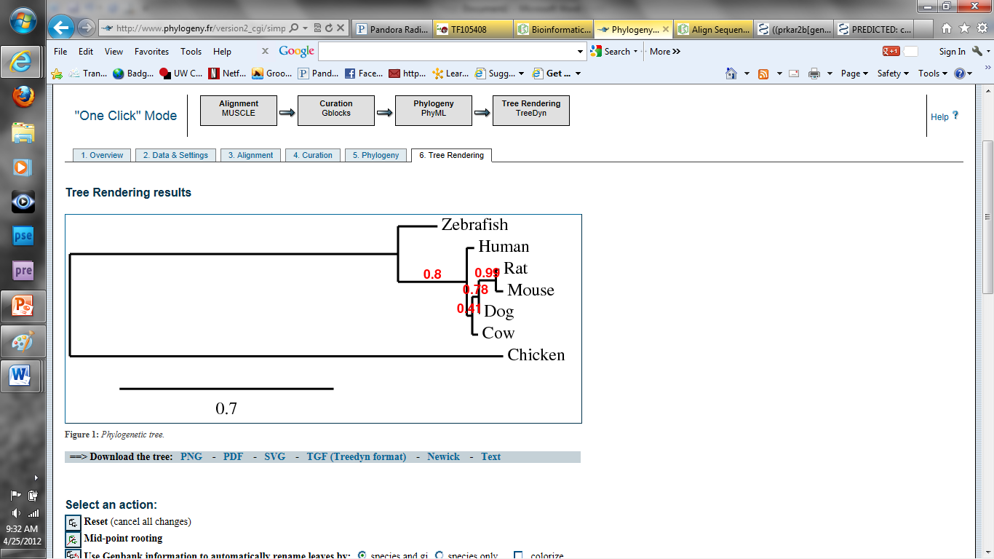
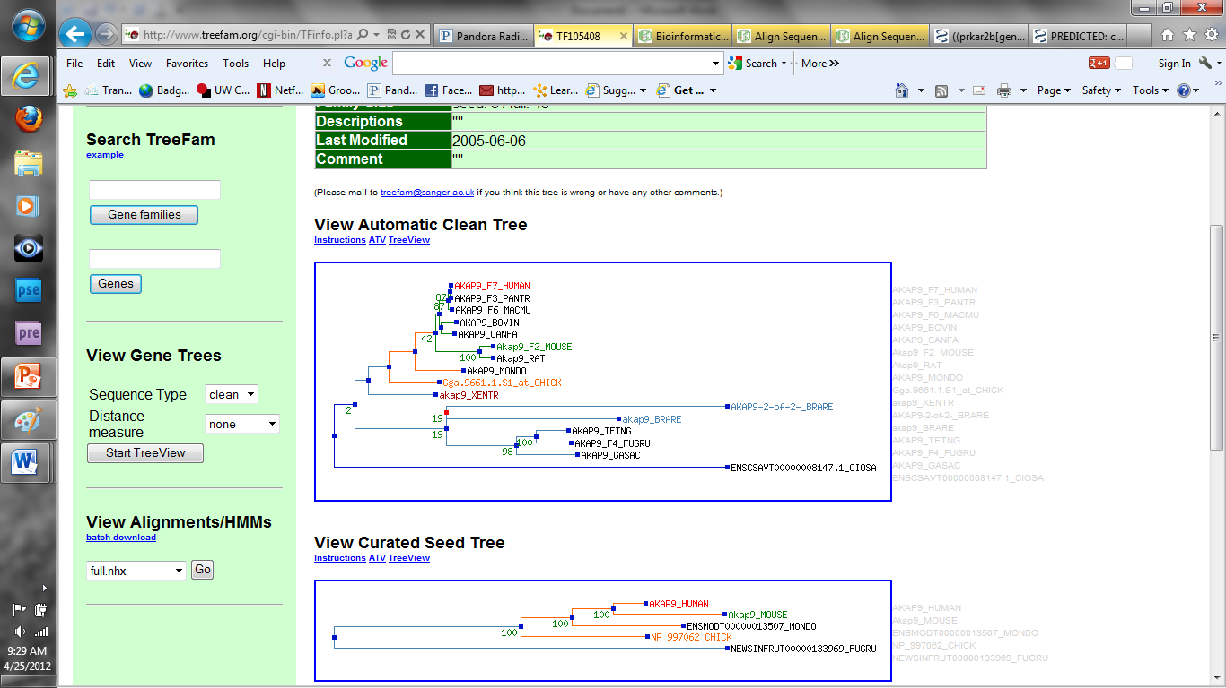
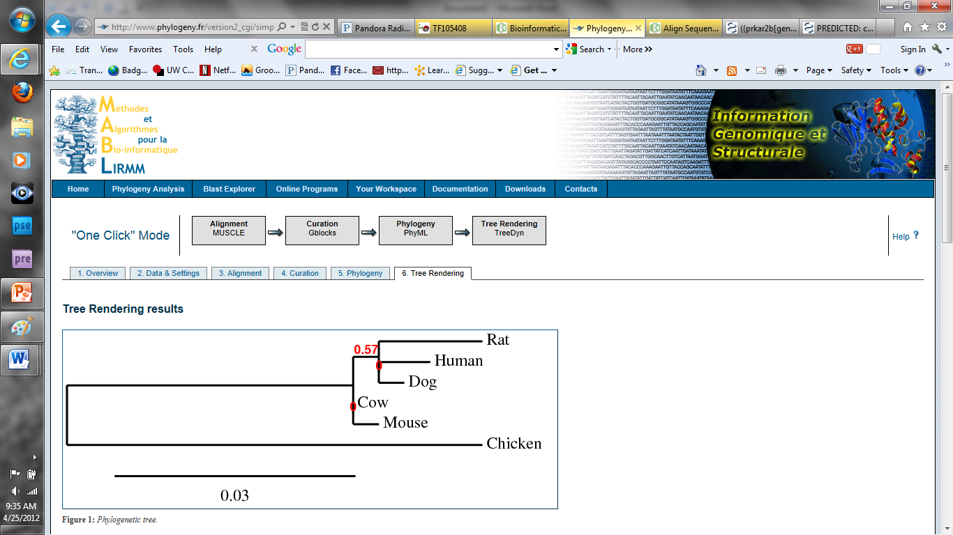
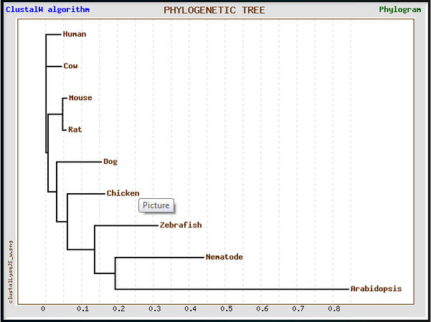
Why use mouse as a model organism?
PRKAR2A
AKAP9
PRKAR2B
KCNQ1

Slide 13
Experiment
Main Hypothesis
The RII binding site in AKAP9 is important in the phosphorylation of KCNQ1.
Experiment Part 1
Establish that AKAP9, PRKAR2A/B, and KCNQ1 localize to the same areas.
Experiment Part 2
Test to see if changes in the AKAP9 RII binding domain effect protein binding
Experiment Part 3
Screen for unknown mutations for further testing.

Slide 14
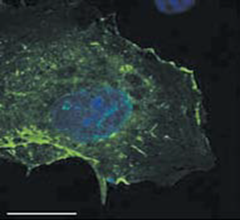
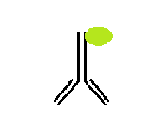
Do all four proteins localize to the same part of the heart cell?
Method: Immunofluorescence analysis of heart cells
Protein
Antibody with fluorophore
Localization of KCNQ1 in heart cells⁵

Slide 15
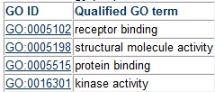
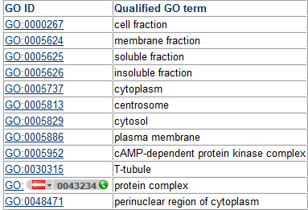
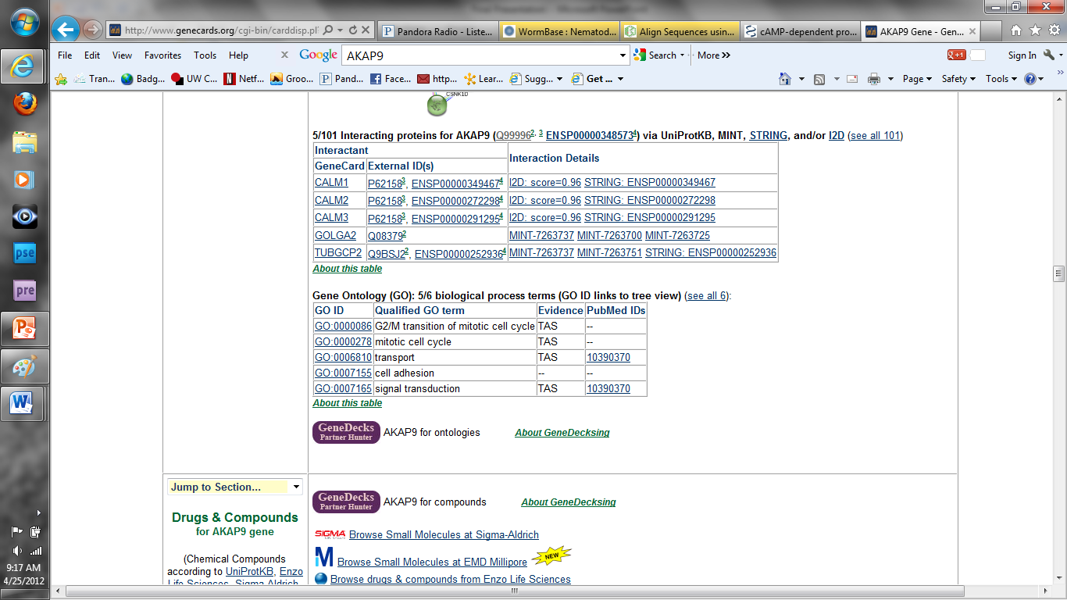
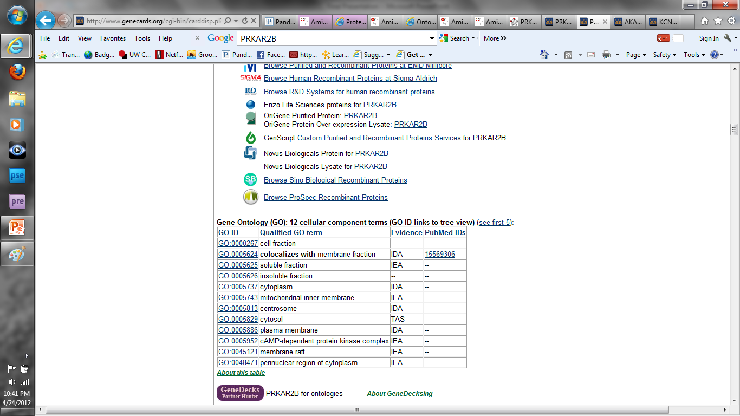
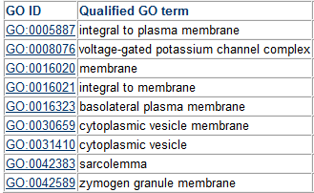
Are all four proteins active in the same cell functions?
Method: Look at gene ontology terms
PRKAR2A³
AKAP9²
PRKAR2B⁴
KCNQ1¹

Slide 16
Experiment
Main Hypothesis
A mutation in the RII binding site in AKAP9 causes a decrease in phosphorylated KCNQ1.
Experiment Part 1
Establish that AKAP9, PRKAR2A/B, and KCNQ1 localize to the same areas.
Experiment Part 2
Test to see if changes in the AKAP9 RII binding domain effect protein binding
Experiment Part 3
Screen for unknown mutations for further testing.

Slide 17

Does changes in AKAP9 RII binding sites effect the binding of PRKAR2A/B?
Method: Microarray of mouse strand AKAP9 protein to look for phosphorylated PRKAR2A/B complex
A: wt AKAP9
B: AKAP9 Δ RII Binding site
RII Binding Domain
Shows wt-AKAP9
Shows AKAP9 ΔRII Binding site
?

Slide 18
Experiment
Main Hypothesis
A mutation in the RII binding site in AKAP9 causes a decrease in phosphorylated KCNQ1.
Experiment Part 1
Establish that AKAP9, PRKAR2A/B, and KCNQ1 localize to the same areas.
Experiment Part 2
Test to see if changes in the AKAP9 RII binding domain effect protein binding
Experiment Part 3
Screen for unknown mutations for further testing.

Slide 19
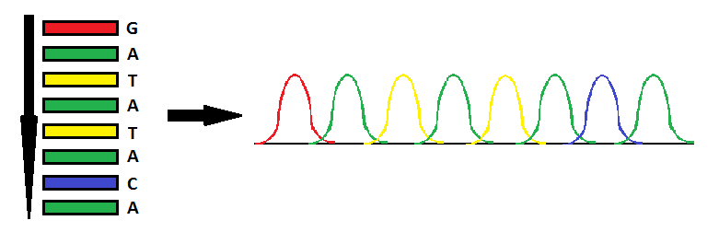
Is there a specific mutation in the RII binding site on AKAP9?
Method: DNA sequencing of patients with Congenital Long-QT Syndrome (LQTS)

Slide 20
Future Directions
Is the mutation that is found in the RII binding site causing a problem in localization of the PRKAR2A/B complex?
Does the same interactions of proteins occur in all cells known to have these proteins?
Is there a mutation in the PRKAR2A/B complex?

Slide 21

Questions

Slide 22
References
1-http://www.genecards.org/cgi-bin/carddisp.pl?gene=KCNQ1
2-http://www.genecards.org/cgi-bin/carddisp.pl?gene=AKAP9
3-http://www.genecards.org/cgi-bin/carddisp.pl?gene=PRKAR2A
4-http://www.genecards.org/cgi-bin/carddisp.pl?gene=PRKAR2B
5-Moretti, Alessandra et al. “Patient-Specific Induced Pluripotent Stem-Cell Models for Long-QT Syndrome”. The New England Journal of Medicine. Vol. 363 No. 15. October 2010.
6-http://www.proteinatlas.org/ENSG00000127914
7-Lim, Chinten et al. “α4 Integrins are Type I cAMP-dependent protein kinase-anchoring proteins”. Nature Cell Biology. No. 9. p.415-421. 2007.
8-Barzi, Mercedes et al. “Sonic-hedgehog-mediated proliferation requires the localization of PKA to the cilium base”. Journal of Cell Science. No. 123. p.62-69. 2010.
9-http://www.nature.com/scitable/content/dna-sequencing-of-rt-pcr-products-can-8854580
10-Wilde, Arthur and Connie Bezzina. “Genetics of Cardiac Arrhythmias”. Heart. Vol. 91. No. 10. 2005.
11-Twedell, Diane Associate Editor. “An Overview of Congenital Long QT Syndrome”. The Journal of Continuing Education in Nursing. January/February 2005. Vol. 36, No 1.
12-http://t0.gstatic.com/images?q=tbn:ANd9GcR9yS9kVqT7GRLliNRXPf-2nv5F-
13-http://ghr.nlm.nih.gov/gene/KCNQ1
14-Protein network maps are all from: http://string.embl.de/newstring_cgi/show_input_page.pl?UserId=q9lK_ccFQ4Ys&sessionId=lDjU _IKBH5RI
15-
16-
17-

